Slide 1
M. Tech (CSE) – Second Semester (Term: June - Oct 2022)
Non-CIE Component
Factoring: Simon’s algorithm and Shor’s algorithm for factoring/discrete log
Department of Computer Science and Engineering
Presented By:
PAVAN G V
[1MS21SCS15]

Slide 2
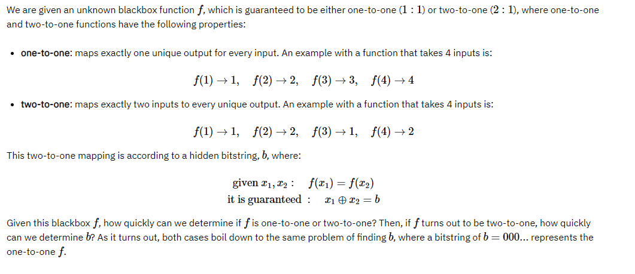
Simon’s Problem

Slide 3
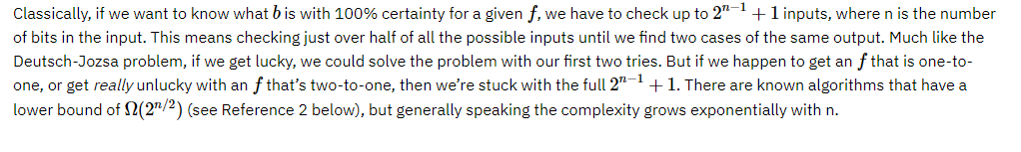
Simon’s Algorithm
Classical solution:

Slide 4
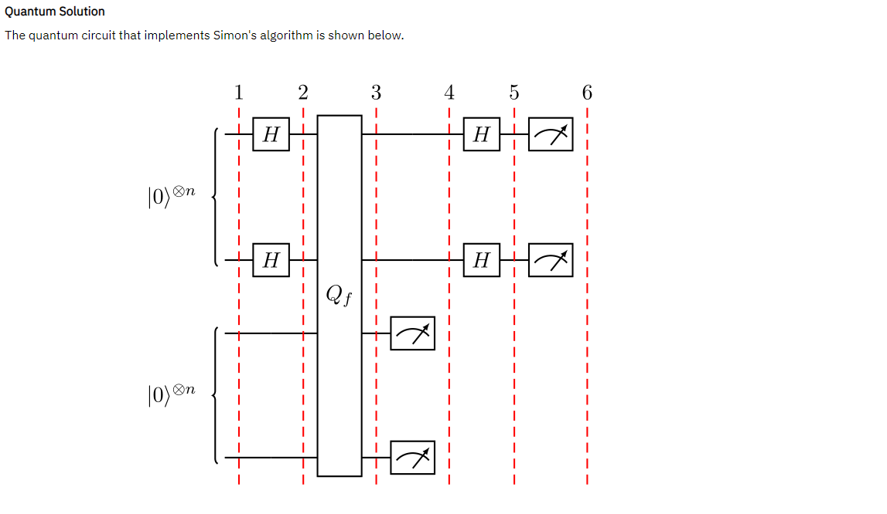

Slide 5
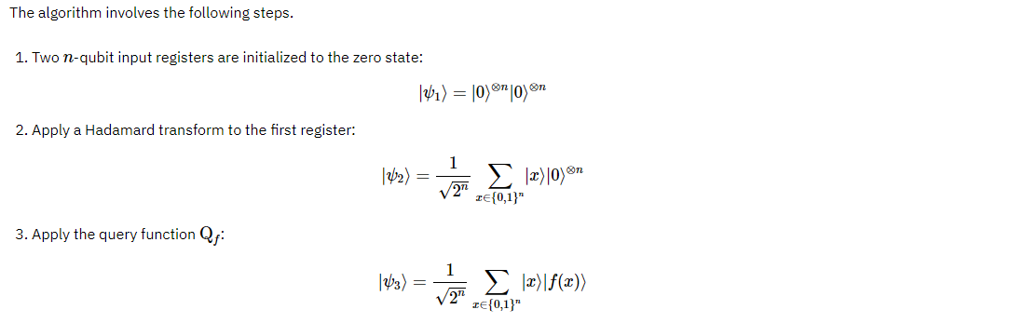

Slide 6
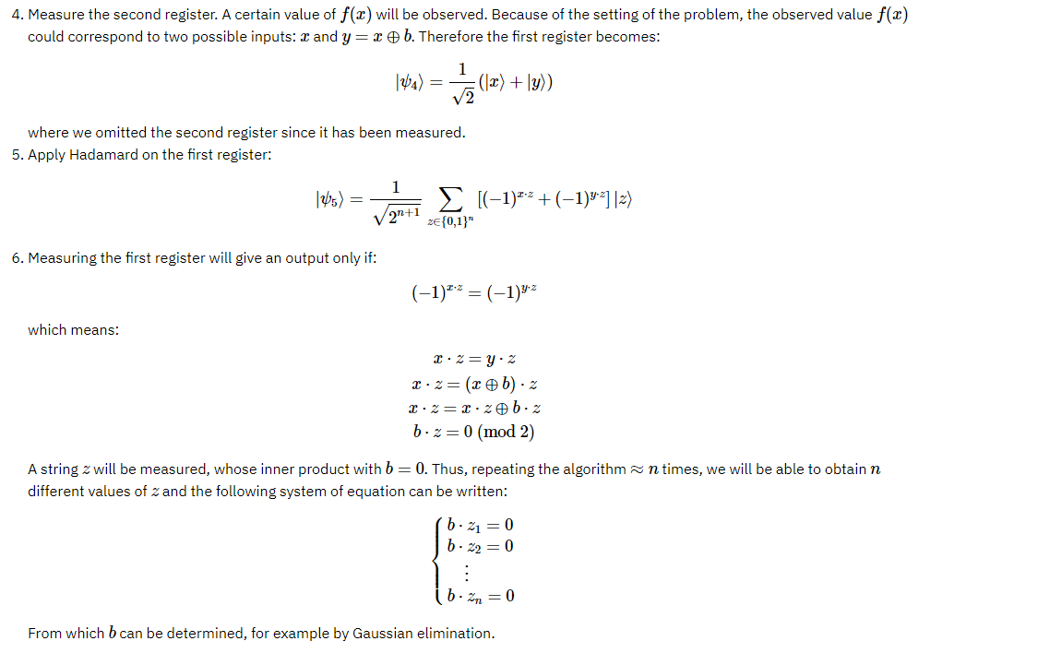

Slide 7
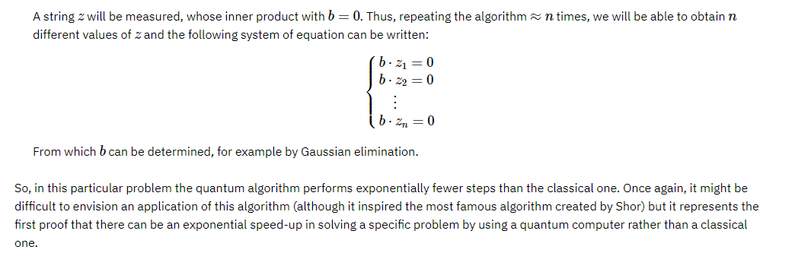

Slide 8
Qiskit Implementation
Let us see the simon algorithm for an example with 3 qubits and b=110.
from qiskit import IBMQ, Aer
from qiskit.providers.ibmq import least_busy
from qiskit import QuantumCircuit, transpile, assemble
from qiskit.visualization import plot_histogram
from qiskit_textbook.tools import simon_oracle

Slide 9
b = '110'
n = len(b)
simon_circuit = QuantumCircuit(n*2, n)
simon_circuit.h(range(n))
simon_circuit.barrier()
simon_circuit += simon_oracle(b)
simon_circuit.barrier()
simon_circuit.h(range(n))
simon_circuit.measure(range(n), range(n))
simon_circuit.draw()

Slide 10
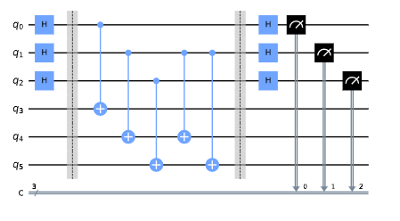

Slide 11
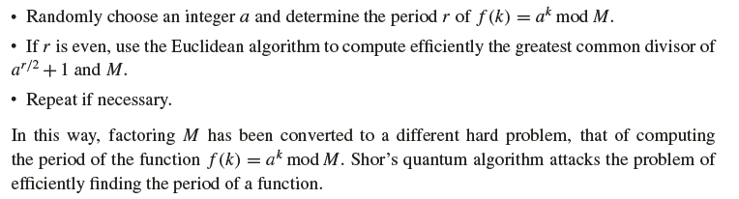
Shor’s Algorithm
Classical reduction to Period finding

Slide 12
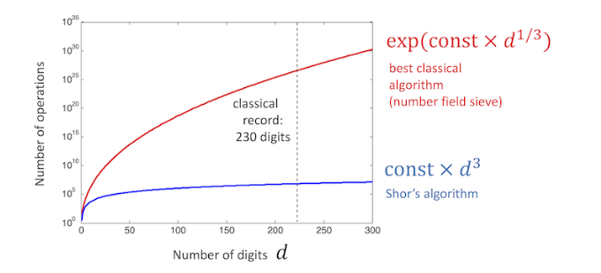
Figure: classical vs. quantum factoring algorithms

Slide 13
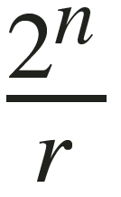

Shor’s Algorithm
Quantum reduction to Period finding
Randomly choose an integer a such that 0 < a <M. Use the Euclidean algorithm to determine whether a and M are relatively prime. If not, we have found a factor of M. Otherwise, apply the rest of the algorithm.
Use quantum parallelism to compute f(x) = a^x modM on the superposition of inputs, and apply a quantum Fourier transform to the result.
Measure with high probability, a value v close to a multiple of will be obtained.
Use classical methods to obtain a conjectured period q from the value v.
When q is even, use the Euclidean algorithm to check efficiently whether
has a nontrivial common factor with M.
Repeat all steps if necessary.

Slide 14


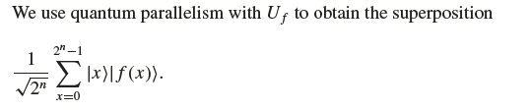

In step two and three:
After using Quantum Parallelism to create the superposition , shor’s algorithm applies the quantum fourier transform.
Since f(x) = a^x modM can be compute efficiently classically, the transformation
Has efficient implementation, then

Slide 15


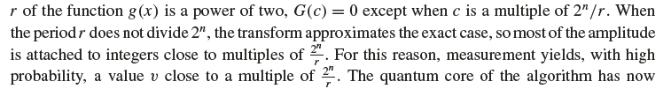
When the period,
Completed.

Slide 16
Qiskit Implementation
import matplotlib.pyplot as plt
import numpy as np
from qiskit import QuantumCircuit, Aer, transpile, assemble
from qiskit.visualization import plot_histogram
from math import gcd
from numpy.random import randint
import pandas as pd
from fractions import Fraction
print("Imports Successful")

Slide 17
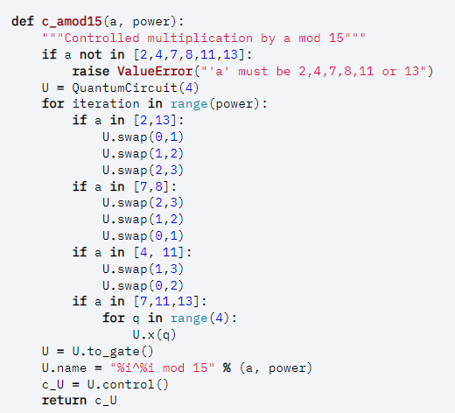

Slide 18
n_count = 8
a = 7
def qft_dagger(n):
"""n-qubit QFTdagger the first n qubits in circ"""
qc = QuantumCircuit(n)
for qubit in range(n//2):
qc.swap(qubit, n-qubit-1)
for j in range(n):
for m in range(j):
qc.cp(-np.pi/float(2**(j-m)), m, j)
qc.h(j)
qc.name = "QFT†"
return qc

Slide 19
qc = QuantumCircuit(n_count + 4, n_count)
for q in range(n_count):
qc.h(q)
qc.x(3+n_count)
for q in range(n_count):
qc.append(c_amod15(a, 2**q),
[q] + [i+n_count for i in range(4)])
qc.append(qft_dagger(n_count), range(n_count))
qc.measure(range(n_count), range(n_count))
qc.draw(fold=-1) # -1 means 'do not fold'

Slide 20
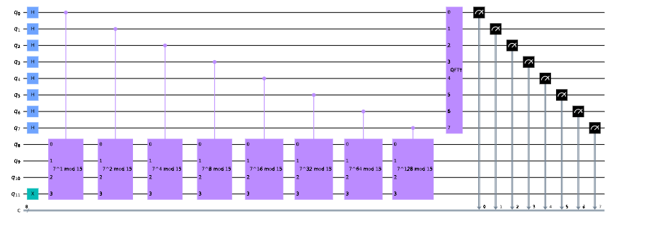

Slide 21
Conclusion
We have seen the simons algorithm to find the hidden string b. And how to implement it using qiskit.
We have seen Shor’s order finding algorithm and it’s functionality with respect to classical algorithms and it’s complexity. Shor’s implementation on Qiskit.

Slide 22
THANK YOU

